Slide 1






Cloud Infrastructure Automation, and
Cloud Migration Technology Company
Huawei VS AWS
Compete Analysis and Business Case
1000 124th Ave NE
Bellevue, WA 98005, USA.
pm@click2cloud.net | + 1 425 749 7495
V-8, Laxmi Nagar,
Nagpur – 440022
contact@click2cloud.net | +91-712-3207999
Red Hat ISV
and Advanced Partner

Slide 2
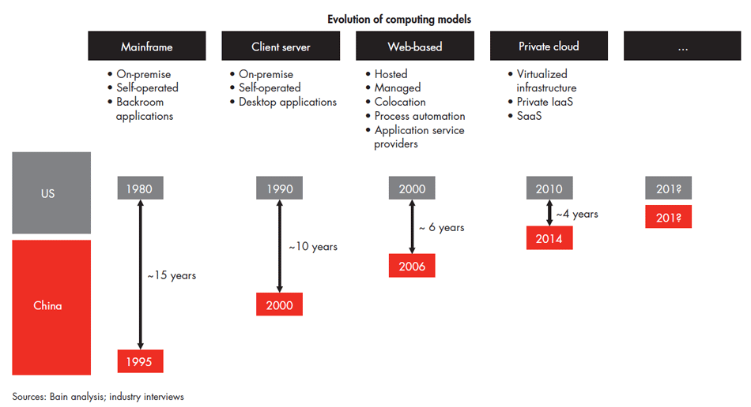
China’s adoption of computing models and IT architectures has historically followed that in the US, but the lag has shortened considerably.
Current Leaders:
AWS, Azure, Alibaba
Reference:
http://bain.com/publications/articles/finding-the-silver-lining-in-chinas-cloud-market.aspx
http://trade.gov/topmarkets/pdf/Cloud_Computing_China.pdf
Red Hat ISV
and Advanced Partner
Click2Cloud Inc.
© 2017 – For Internal Use Only

Slide 3

Top 13 Cloud Providers in China
Reference:
https://medium.com/flow-ci/top-12-1-local-aws-alternatives-in-china-alibaba-cloud-and-beyond-20651fc133b0
1. Alibaba Cloud （阿里云）
2. Baidu Cloud (百度云)
3. Meituan Open Services (美团云）
4. Tencent Cloud (腾讯云）- 500+ locations
5. Ucloud - 10 datacenters worldwide and 11 domestically – 20,000+ enterprise users
6. QingCloud (青云）
7. Huawei Enterprise Cloud （华为企业云）
8. NetEase Cloud (网易蜂巢）
9. Western Digital (西部数码）
10. Elephant Cloud （象云）
11. E Cloud (天翼云）
12. Grand Cloud (盛大云）
13. KS Cloud ( 金山云）
No. 1
Public cloud vendor in China (IDE 2014)
14
International data centers
To achieve this they need
4.0 Million Total Customers
1.0 Million Paying customer
530+
CDN nodes around the world
650K+
Paying Customers
2.6 M
Customers worldwide
40%
GROWTH TARGETD BY 2018
Red Hat ISV
and Advanced Partner
Click2Cloud Inc.
© 2017 – For Internal Use Only
Notes:
In China, more than 250 city governments have declared their interest in constructing smart cities.
451 Research’s Market Monitor predicts that China will emerge as cloud powerhouses in terms of
revenue, generating a market worth over $1.59bn in revenue, with a CAGR of 27% through 2020
Although global cloud providers such as AWS and Microsoft Azure are not foreign to local businesses in
China, they are hardly the only game in town. According to 451 Research’s Market Monitor, in China alone, there are nearly 200 cloud vendors operating or doing business in the cloud computing as-a-service
(CCaaS) market.
According to 451 Research’s Market Monitor, the total Cloud Computing as a Service market in China stood at $482m for 2015

Slide 4


Huawei Cloud - Major Competitors
Worldwide
AWS Cloud | Microsoft Azure | IBM Bluemix | Google Cloud | Salesforce
China
Alibaba Cloud | Meituan Open Services | Tencent Cloud | U Cloud | Qing Cloud |
Ref: https://medium.com/flow-ci/top-12-1-local-aws-alternatives-in-china-alibaba-cloud-and-beyond-20651fc133b0
Red Hat ISV
and Advanced Partner
Click2Cloud Inc.
© 2017 – For Internal Use Only
Notes:
Top 13 Cloud Providers in china
https://medium.com/flow-ci/top-12-1-local-aws-alternatives-in-china-alibaba-cloud-and-beyond-20651fc133b0
451 Research’s :
In China, more than 250 city governments have declared their interest in constructing smart cities.
451 Research’s Market Monitor predicts that China will emerge as cloud powerhouses in terms of
revenue, generating a market worth over $1.59bn in revenue, with a CAGR of 27% through 2020
Although global cloud providers such as AWS and Microsoft Azure are not foreign to local businesses in
China, they are hardly the only game in town. According to 451 Research’s Market Monitor, in China alone, there are nearly 200 cloud vendors operating or doing business in the cloud computing as-a-service
(CCaaS) market.
According to 451 Research’s Market Monitor, the total Cloud Computing as a Service market in China stood at $482m for 2015

Slide 5
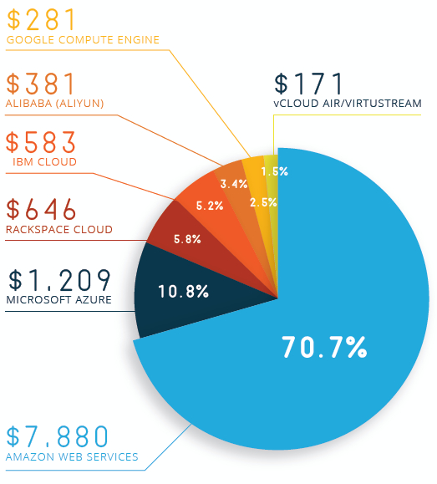
Market Size of Cloud for IaaS, PaaS and SaaS (2015-2018)
PaaS Market Stats
All values are in Million Dollar
Current (2015) and expected (2018) market size for cloud business
Growth Expected in coming three years
Source: Massive-Scale Cloud, April 30, 2016, Structure Research
Red Hat ISV
and Advanced Partner
Click2Cloud Inc.
© 2017 – For Internal Use Only

Slide 6
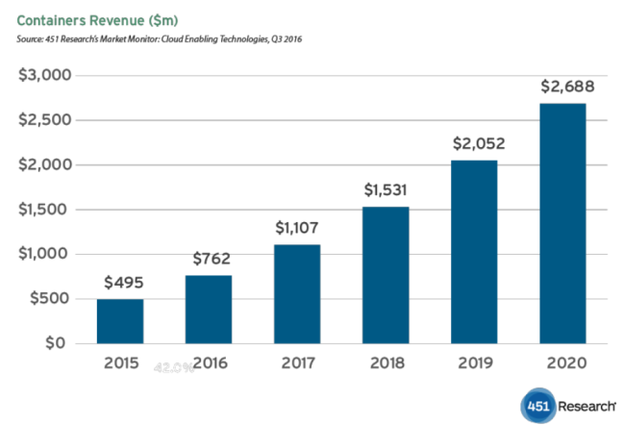
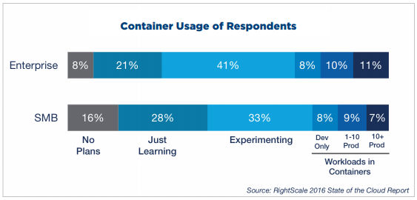
Containers Revenue ($m) by Docker
Container Adoption Stats
Ref: https://cote.io/2017/04/22/the-news-from-docker-land-plus-the-money-being-fought-over-notebook/
Ref: https://www.coscale.com/blog/docker-usage-statistics-increased-adoption-by-enterprises-and-for-production-use
Red Hat ISV
and Advanced Partner
Click2Cloud Inc.
© 2017 – For Internal Use Only

Slide 7
OpenShift Market Stats
2.5 Million+
Application created
(OpenShift Online)
June-2015
100%
year-over-year growth
Over 1 Billion
Requests per day
Over 200+
Add-ons & Quick-starts
OpenShift Online – Supported by AWS
OpenShift Dedicated – Supported by Google
Public Cloud Spending to Double to $141B in 2019, According to IDC - http://solutionsreview.com/cloud-platforms/public-cloud-spending-to-double-to-141b-in-2019-according-to-idc/
Red Hat ISV
and Advanced Partner
Click2Cloud Inc.
© 2017 – For Internal Use Only

Slide 8






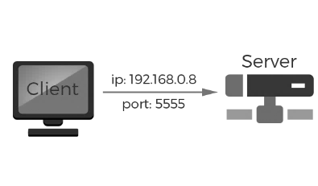


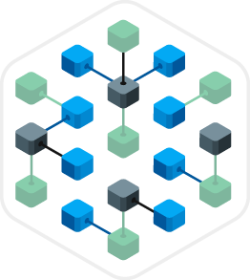


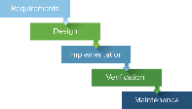
IT Transformation Required to Meet Changing Business Demands
IT
Infrastructure
Data Center
Hosted/Managed
Cloud
Application
Deployment
Physical Server
Virtual Server
Containers
Application Architecture
Monolithic
N-Tier
Micros Services
Deployment Process
Waterfall
Agile
DevOps
Red Hat ISV
and Advanced Partner
Click2Cloud Inc.
© 2017 – For Internal Use Only

Slide 9




How we are helping other Cloud Providers
We partner worldwide with large cloud provider like Alibaba, AWS, IBM, Azure and RedHat for extending their capabilities for the respective clouds through; Infrastructure Automation, Migrations, App Containerization & DevOps.
Implementing OpenShift Platform-as-a-Service (PaaS).
Enabling Infrastructure automation using tools such as; Ansible, Chef, Puppet, Salt-Stack and Terraform
App Migration between cloud; Migrating app from AWS, Azure to Alibaba Cloud
App Containerization & CI/CD states: Docker, Kubernetes
Help users deploy and run applications on Alibaba straight from their IDEs like; Eclipse IDE, Jet Brains IDEs, Visual Studio IDE
Training and support for end-to-end implementation
APP Migrations and cloud services enablement using Terraform & Azure Resource Manager (ARM) Templates.
Container extension for Visual Studio IDE to deploy containerized App to IBM Bluemix Cloud.
Developed the OpenShift DevOps extension for Visual Studio
Developing ready to use project templates

Slide 10

AWS Frequently Used Services
The Above Chart Shows the % wise listing of frequently used services of AWS.
Huawei can take this as a reference and prioritise the services they need to focus on.
Huawei Services
OBS
ECS
-NA-
Simple Msg. Notification
-NA-
VPC
Monitoring Mgt. Interface -NA-
-NA-
-NA-
-NA-
Red Hat ISV
and Advanced Partner
Click2Cloud Inc.
© 2017 – For Internal Use Only

Slide 11





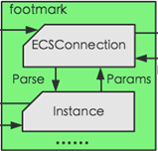







Cloud features & related automations for customers
End users consume Ansible Playbooks to manage cloud infra.
API
WORKBENCH CALLS
ANSIBLE
PLAYBOOKS
MODULES
Every “Cloud Feature” has various “modules” and every module has further Itemized features called “interface”
Each interface needs an API OR SDK for integration with Workbench
Workbench is Middle layer that facilitates integration and talking to Ansible
Ansible Playbook are set of templates having instructions to manage configurations & deployments to remote machines
Huawei as a Cloud Provider provides various Cloud Features such as; Compute, database, storage etc.
Red Hat ISV
and Advanced Partner
Click2Cloud Inc.
© 2017 – For Internal Use Only

Slide 12
ECS(Huawei) – vs – EC2(AWS) Analysis
5 vs 21
MODULES
32 Vs 130
API
0 vs 74
WORKBENCH CALLS
0 vs 74
ANSIBLE
PLAYBOOKS
Elastic Compute Service is one of the feature of Huawei “Elastic Cloud”
Huawei (5) and AWS(21) Modules in Elastic Compute Services
sub-features(interfaces);
Huawei(32) Vs AWS (130)
API available Huawei-32
AWS - 130
Huawei has 0 Workbench calls (APIs) available and AWS has 74
Huawei has 0 Ansible Playbooks available and AWS has 74
Red Hat ISV
and Advanced Partner
Click2Cloud Inc.
© 2017 – For Internal Use Only

Slide 13
ECS(Huawei) – vs – Compute Service(Azure) Analysis
5 Vs 12
MODULES
32 vs 79
API
0 vs 6
WORKBENCH CALLS
0 vs 6
ANSIBLE
PLAYBOOKS
Elastic Compute Service is one of the feature of Huawei “Elastic Cloud”
Huawei(5) and Azure(12) ; Modules in Elastic Compute Services and, sub-features(interfaces)
Huawei(32) Vs Azure(79)
Huawei has 32 APIs, and Azure has 79
Huawei has 0 Workbench calls (APIs) available and Azure has 6
Huawei has 0 Ansible Playbooks available and Azure has 6
In Azure, the API’s sub-operations like; create, update, delete etc.. have been combined as a single API.. SO THE COUNT IS LESS
Red Hat ISV
and Advanced Partner
Click2Cloud Inc.
© 2017 – For Internal Use Only

Slide 14
ECS(Huawei) – vs – Compute Service(Alibaba) Analysis
5 Vs 11
MODULES
32 vs 81
API
0 vs 23
WORKBENCH CALLS
0 vs 23
ANSIBLE
PLAYBOOKS
Elastic Compute Service is one of the feature of Huawei “Elastic Cloud”
Huawei(5) and Alibaba(11) ; Modules in Elastic Compute Services and, sub-features(interfaces)
Huawei(32) Vs Alibaba(58)
Huawei has 32 APIs, and Alibaba has 81
Huawei has 0 Workbench calls (APIs) available and Alibaba has 23
Huawei has 0 Ansible Playbooks available and Alibaba has 23
Red Hat ISV
and Advanced Partner
Click2Cloud Inc.
© 2017 – For Internal Use Only

Slide 15
Huawei -vs- Alibaba -vs- AWS (Side by Side analysis)
Feature Name in Huawei | Cloud Feature-Itemized | API Available for Automation | Interfaces Implemented by Huawei
Huawei | 9 | 229 | 0
Elastic Cloud Server | 1 | 32 | 0
Image Management Service | 1 | 20 | 0
Elastic Volume Service | 1 | 21 | 0
Volume Backup Service | 1 | 16 | 0
Object Storage Service | 1 | 48 | 0
VPC | 1 | 33 | 0
Elastic Load Balance | 1 | 22 | 0
Cloud Eye | 1 | 9 | 0
Elastic BigData | 1 | 28 | 0
Feature Name in Alibaba | Cloud Feature-Itemized | API Available for Automation | Interfaces Implemented by Alibaba
Alibaba | 117 | 79 | 63
ECS | 11 | 81 | 23
VPC | 10 | 48 | 10
SLB | 7 | 58 | 14
Auto Scaling | 6 | 22 | 0
Container Service | 3 | 24 | 0
ROS | 4 | 15 | 0
RDS | 10 | 72 | 12
OSS | 5 | 45 | 4
Table Storage | 1 | 18 | 0
Alibaba Cloud CDN | 7 | 82 | 0
Express Connect | 5 | 26 | 0
E-Map Reduce | 3 | 23 | 0
Message Service | 6 | 26 | 0
Cloud Monitor | 1 | 3 | 0
RAM | 6 | 61 | 0
KMS | 1 | 15 | 0
API Gateway | 9 | 76 | 0
Mobile Security | 2 | 4 | 0
N/A | 0 | 0 | 0
Feature Name in AWS | Cloud Feature-Itemized | API Available for Automation | Interfaces Implemented by AWS
AWS | 83 | 1681 | 349
EC2 | 21 | 130 | 74
VPC | 8 | 45 | 13
ELB | 3 | 20 | 20
Auto Scaling | 1 | 28 | 9
Container Service | 1 | 35 | 18
AWS Cloud Formation | 1 | 26 | 9
RDS | 1 | 91 | 90
Elasticache | 1 | 38 | 16
S3 | 1 | 57 | 9
DynamoDB | 2 | 23 | 3
Direct Connect | - | - | -
N/A | - | - | -
SQS | 2 | 14 | 3
Cloud Watch | 1 | 12 | 3
IAM | 1 | 60 | 1
KMS | 1 | 35 | 0
N/A | - | - | -
WAF | 2 | 78 | 0
View Detailed Analysis Report

Slide 16

Huawei Automation for features
Azure Automation for features
Azure has done the Ansible Automation for Storage and Networking services
Huawei has lot of scope for Ansible Automation of its Services

Slide 17

Huawei Automation for features
Alibaba is slowly catching up to provide Ansible automation for its many services
Huawei has lot of scope for Ansible Automation of its Services

Slide 18
Below statistics is for Overall Ansible Playbook Availability Status for Huawei, Alibaba, Azure and AWS. You can see;
Column 1 – Total cloud services
Column 2 - Total APIs Available for developers
Column 3 - Ansible Playbook Available for developers
Stats for Ansible implementation: AWS Vs Azure Vs Alibaba Vs Huawei
You can see in the chart:
The API required for Huawei is more than Alibaba & AWS
Huawei still needs to develop 229(229-0) Workbench calls (Interfaces)
Huawei is lagging in providing 229( 229-0) Ansible Playbooks in market
Alibaba with 63 and AWS with 349 Ansible Playbook is way ahead of the Huawei’s 0
Huawei has converted 0% of their Workbench call (interfaces) in to Ansible Playbooks as compared with Alibaba which is 8% and AWS which is 21%
Minimum scope in current phase = Ansible Playbook implementation for 229 (229-0) Workbench calls (interfaces)

Slide 19

Huawei Vs Alibaba Vs AWS Vs Azure - Stats
APIs Required Verses Ansible Playbook Implemented
229 APIs needs “Ansible Automation Playbooks” for Huawei, 0 playbooks are ready.
731 APIs needs “Ansible Automation Playbooks” for Alibaba, only 63 playbooks are ready for Alibaba.
1332 APIs needs “Ansible Automation Playbooks” for AWS, 349 playbooks are ready for AWS.
1203 APIs needs “Ansible Automation Playbooks” for Azure, 36 playbooks are ready for Azure.
Red Hat ISV
and Advanced Partner
Click2Cloud Inc.
© 2017 – For Internal Use Only

Slide 20
Huawei Vs Alibaba Vs AWS Vs Azure - Stats
Workbench calls (interfaces) available Verses Ansible Playbook Implemented
Total 299 (299+0) Workbench Calls (Interfaces) are ready for Huawei Automation, but 0% (0) playbooks have been implemented, still 100% (299) needs to be implemented.
Total 794 (731+63) Workbench Calls (Interfaces) are ready for Alibaba Automation, but only 8% (63) playbooks have been implemented, still 92% (731) needs to be implemented.
Total 1681 (1332+349) Workbench Calls (Interfaces) are ready for AWS Automation, and 21% (349) playbooks have been implemented, and the implementation for 79% (1332) is in progress.
Total 1239 (1203+36) Workbench Calls (Interfaces) are ready for Azure Automation, and 3% (36) playbooks have been implemented, and the implementation for 97% (1203) is in progress.
Red Hat ISV
and Advanced Partner
Click2Cloud Inc.
© 2017 – For Internal Use Only

Slide 21
Huawei Vs Alibaba Vs AWS Vs Azure- Stats
Stats Considering Workbench calls (interfaces) availability
In-total 229 (0+229) Workbench Calls (Interfaces) are required….and 0% (0) Workbench calls are available for automation. Huawei still needs to create 100% (229) Workbench calls.
In-total 794 (63+731) Workbench Calls (Interfaces) are required….and Only 8% (63) Workbench calls are available for automation. Alibaba still needs to create 92% (731) Workbench calls.
AWS has a needs of total 1681 (349+1332) Workbench Calls (Interfaces)….and already 21% (349) Workbench calls are available for automation. AWS just needs to create 79% (1332) Workbench calls.
Azure has a needs of total 1239 (36+1203) Workbench Calls (Interfaces)….and already 3% (36) Workbench calls are available for automation. Azure needs to create 97% (1203) Workbench calls.
Red Hat ISV
and Advanced Partner
Click2Cloud Inc.
© 2017 – For Internal Use Only

Slide 22

Elastic Computing Stats
Feature Name in Huawei | Cloud Feature-Itemized | API Available for Automation | Interfaces Implemented by Huawei
Huawei | 12 | 54 | 0
ECS | 5 | 32 | 0
ELB | 7 | 22 | 0
N/A | - | - | -
N/A | - | - | -
Feature Name in Alibaba | Cloud Feature-Itemized | API Available for Automation | Interfaces Implemented by Alibaba
Alibaba | 27 | 185 | 37
ECS | 11 | 81 | 23
SLB | 7 | 58 | 14
Auto Scaling | 6 | 22 | 0
Container Service | 3 | 24 | 0
Feature Name in AWS | Cloud Feature-Itemized | API Available for Automation | Interfaces Implemented by AWS
AWS | 26 | 213 | 121
ECS | 21 | 130 | 74
ELB | 3 | 20 | 20
Auto Scaling | 1 | 28 | 9
Container Service | 1 | 35 | 18
Red Hat ISV
and Advanced Partner
Click2Cloud Inc.
© 2017 – For Internal Use Only

Slide 23

Storage & Networking Stats
Feature Name in Huawei | Cloud Feature-Itemized | API Available for Automation | Interfaces Implemented by Huawei
Huawei | 9 | 81 | 0
OBS | 1 | 48 | 0
N/A | - | - | -
N/A | - | - | -
VPC | 8 | 33 | 0
Feature Name in Alibaba | Cloud Feature-Itemized | API Available for Automation | Interfaces Implemented by Alibaba
Alibaba | 28 | 219 | 14
OSS | 5 | 45 | 4
Table Storage | 1 | 18 | 0
Alibaba Cloud CDN | 7 | 82 | 0
VPC | 10 | 48 | 10
Express Connect | 5 | 26 | 0
Feature Name in AWS | Cloud Feature-Itemized | API Available for Automation | Interfaces Implemented by AWS
AWS | 11 | 125 | 25
S3 | 1 | 57 | 9
Dynamo DB | 2 | 23 | 3
Cloud Front | - | - | -
VPC | 8 | 45 | 13
Direct Connect | - | - | -
Red Hat ISV
and Advanced Partner
Click2Cloud Inc.
© 2017 – For Internal Use Only

Slide 24

Database Service Stats
Feature Name in Huawei | Cloud Feature-Itemized | API Available for Automation | Interfaces Implemented by Huawei
Huawei | 0 | 0 | 0
N/A | - | - | -
N/A | - | - | -
Feature Name in Alibaba | Cloud Feature-Itemized | API Available for Automation | Interfaces Implemented by Alibaba
Alibaba | 10 | 72 | 12
ApsaraDB for RDS | 10 | 72 | 12
Apsara BD for Memcache | - | - | -
Feature Name in AWS | Cloud Feature-Itemized | API Available for Automation | Interfaces Implemented by AWS
AWS | 2 | 129 | 106
RDS | 1 | 91 | 90
Elasticache | 1 | 38 | 16
Red Hat ISV
and Advanced Partner
Click2Cloud Inc.
© 2017 – For Internal Use Only

Slide 25

Security Stats
Feature Name in Huawei | Cloud Feature-Itemized | API Available for Automation | Interfaces Implemented by Huawei
Huawei | 0 | 0 | 0
N/A | - | - | -
N/A | - | - | -
N/A | - | - | -
Feature Name in Alibaba | Cloud Feature-Itemized | API Available for Automation | Interfaces Implemented by Alibaba
Alibaba | 8 | 65 | 0
WAF | - | - | -
RAM | 6 | 61 | 0
Mobile Security | 2 | 4 | 0
Feature Name in AWS | Cloud Feature-Itemized | API Available for Automation | Interfaces Implemented by AWS
AWS | 3 | 138 | 1
WAF | 2 | 78 | 0
IAM | 1 | 60 | 1
N/A
Red Hat ISV
and Advanced Partner
Click2Cloud Inc.
© 2017 – For Internal Use Only

Slide 26
Management Tools, Messaging and Other features Stats
Feature Name in Huawei | Cloud Feature-Itemized | API Available for Automation | Interfaces Implemented by Huawei
Huawei | 19 | 94 | 0
IMS | 5 | 20 | 0
EVS | 2 | 21 | 0
VBS | 2 | 16 | 0
CloudEye | 4 | 9 | 0
Elastic BigData | 6 | 28 | 0
Feature Name in Alibaba | Cloud Feature-Itemized | API Available for Automation | Interfaces Implemented by Alibaba
Alibaba | 24 | 158 | 0
ROS | 4 | 15 | 0
E-Map Reduce | 3 | 23 | 0
Message Service | 6 | 26 | 0
Cloud Monitor | 1 | 3 | 0
KMS | 1 | 15 | 0
API Gateway | 9 | 76 | 0
Feature Name in AWS | Cloud Feature-Itemized | API Available for Automation | Interfaces Implemented by AWS
AWS | 9 | 99 | 27
AWS Cloud Formation | 1 | 26 | 9
N/A | - | - | 0
SQS | 2 | 14 | 3
Cloud Watch | 1 | 12 | 3
KMS | 1 | 35 | 0
N/A | - | - | 0
Red Hat ISV
and Advanced Partner
Click2Cloud Inc.
© 2017 – For Internal Use Only

Slide 27




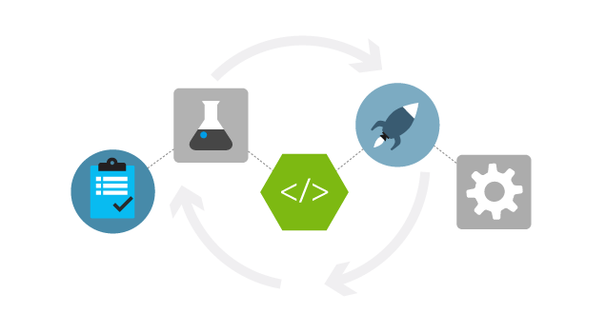
Click2Cloud Services
Infra.
as a
Service
Migration
as a
Service
PaaS
as a
Service
Container
as a
Service
CI/CD
Dev-OPs
as a
Service
Cloud Infra. Automation Services
Cloud to Cloud, App and DB migration
Cloud Foundry and Red Hat OpenShift
App Containerization, Legacy app support
Tools for Eclipse, Visual Studio IDE
Red Hat ISV
and Advanced Partner
Click2Cloud Inc.
© 2017 – For Internal Use Only

Slide 28
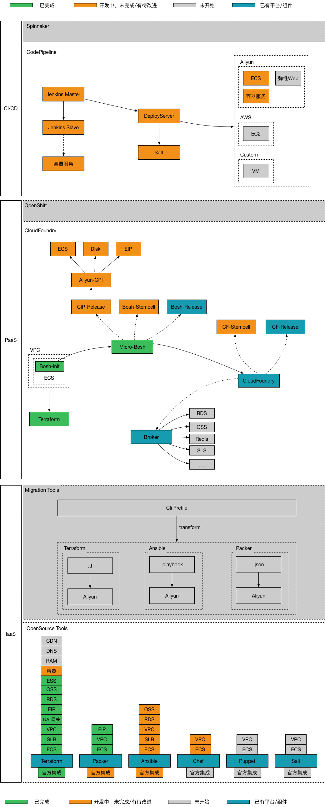
Infra as a Service – OpenSource Tools
I
a
a
S
Red Hat ISV
and Advanced Partner
Click2Cloud Inc.
© 2017 – For Internal Use Only

Slide 29
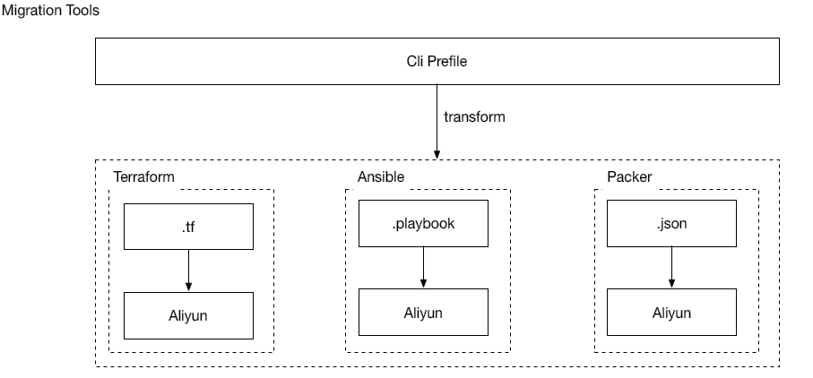
Infra as a Service – Migration Tools
I
a
a
S
Services:
Infrastructure migration from Cloud to Cloud
Legacy application migration
Database migration
Red Hat ISV
and Advanced Partner
Click2Cloud Inc.
© 2017 – For Internal Use Only

Slide 30
PaaS – Cloud Foundry
P
a
a
S
Cloud Foundry
Red Hat ISV
and Advanced Partner
Click2Cloud Inc.
© 2017 – For Internal Use Only

Slide 31

PaaS – Red Hat OpenShift
Public IP
Administration Traffic
OpenShift Container Traffic
Load Balanced Traffic
P
a
a
S
Provisioning Cloud Foundry PaaS
Provisioning Red Hat OpenShift PaaS
VPC
Bastion Host
Ext. SLB
Router SLB
Cloud DNS
Internal SLB
RAM (Auth)
Router
Router
Master 1
Master 2
App 1
App 2
Infra 1
Infra 2
…
…
Disk
Disk
Container
Container
…
Registry
Registry
OpenShift Master
OpenShift Infra Nodes
Disk
Disk
OpenShift App Nodes
OSS
Notes:
The Bastion host limits the external access to internal servers by ensuring that all SSH traffic passes through the Bastion host.
The Master instances host the OpenShift master components such as etcd and the OpenShift API.
The Application instances are for users to deploy their containers
The Infrastructure instances are used for the OpenShift router and registry.
Disk is used for the filesystem of instances and can also be used for persistent storage in containers.
OSS is used for the persistent storage of the OpenShift registry.
The network is configured to leverage three SLBs for access to the OpenShift API, OpenShift console, and the OpenShift routers.
The first SLB (External SLB) is for the OpenShift API and console access originating from outside of the cluster.
The second SLB (Internal SLB) is for API access within the cluster.
The third SLB (Router SLB) is for accessing services deployed in the cluster (Pods) that have been exposed through routes.
All resources are registered with Cloud DNS.
Ref: https://access.redhat.com/documentation/en-us/reference_architectures/2017/html-single/deploying_openshift_container_platform_3.5_on_amazon_web_services/#components_and_configuration
https://blog.openshift.com/openshift-container-platform-reference-architecture-implementation-guides/

Slide 32
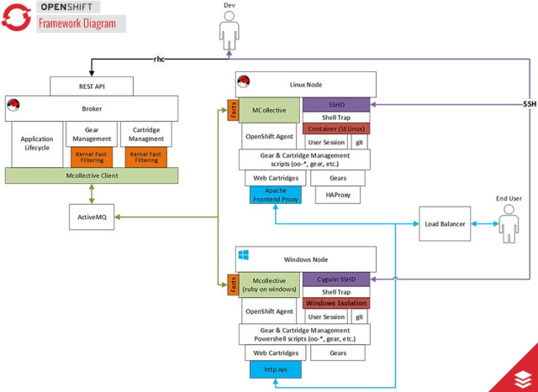
PaaS – Red Hat OpenShift 2.0
P
a
a
S

Slide 33







Container as a Service
C
a
a
S
Microservices O/S (Docker)
Kubernetes / Docker Swarm and Mesos
Services:
App Containerization Service
Light weight OS Testing
Dev-Ops / CI-CD Integration
IDE Plugins
GitHub
AWS
Build (Jenkins)
Bit Bucket
S2I – Standalone Tool
Azure
TFS
Alibaba

Slide 34
CI/CD & DevOps as a Service
CI
CD
&
Dev
Ops
Code Pipeline
Services:
DevOps – CI/CD tools with Extensions (Visual Studio, Eclipse and IntelliJ IDE)
Red Hat ISV
and Advanced Partner
Click2Cloud Inc.
© 2017 – For Internal Use Only

Slide 35
Solutions Developed on Cloud
Red Hat ISV
and Advanced Partner
Global Delivery Model
24 X 7 Follows the Sun support model
Click2Cloud Inc.
© 2017 – For Internal Use Only

Slide 36
Recent Apps developed using Azure services
First Response Online – ASP.NET with Azure DB and DocumentDB
Demo SkiApp – Xamarine with Azure DB
Day Planner Application - NodeJS with PostgreSQL
Meeting directory - Ruby-on-Rails with PostgreSQL
Red Hat ISV
and Advanced Partner
Click2Cloud Inc.
© 2017 – For Internal Use Only

Slide 37
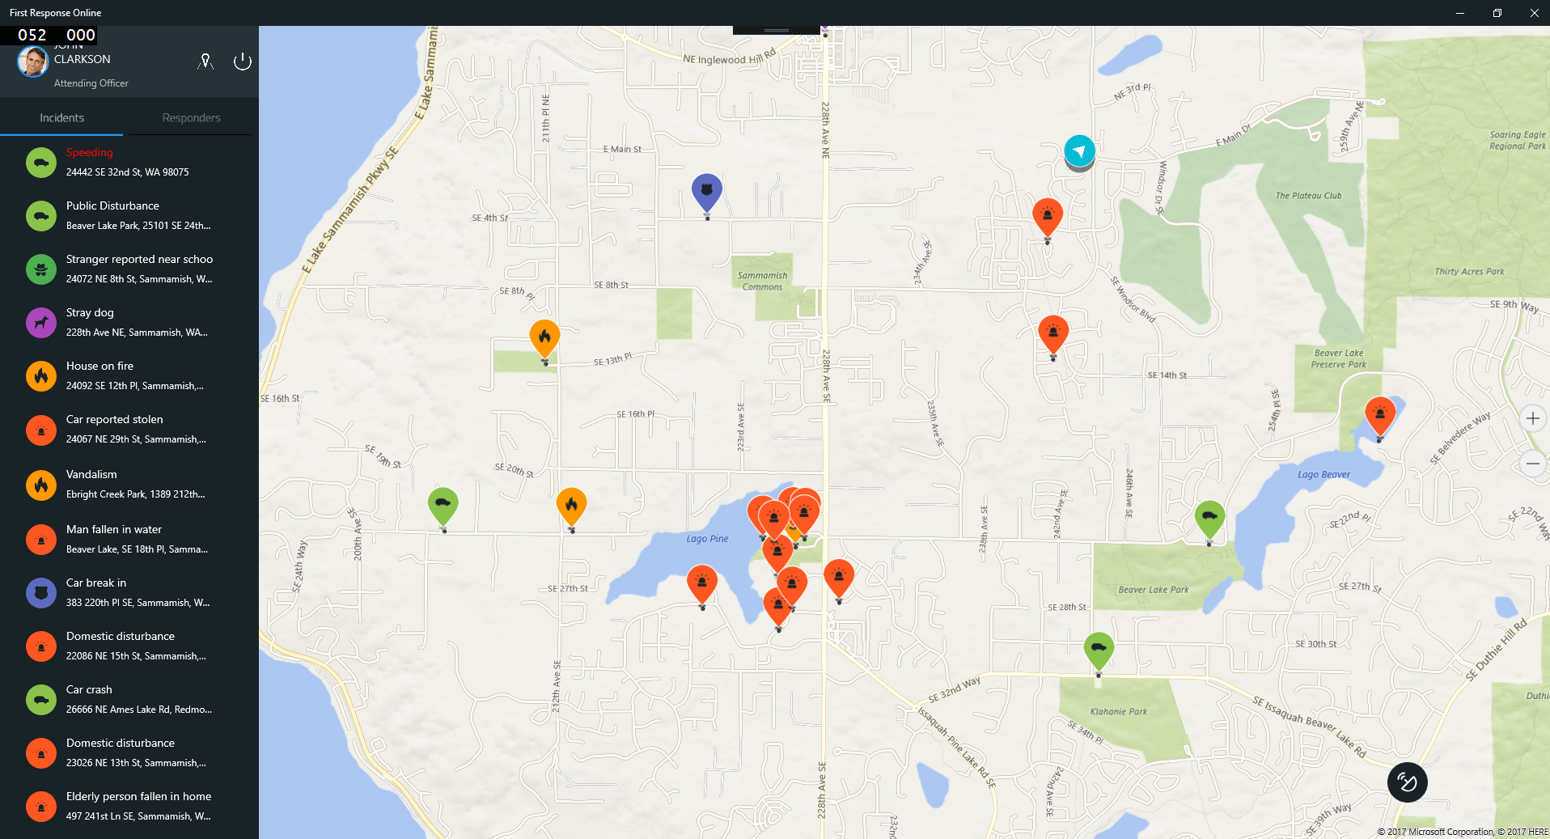
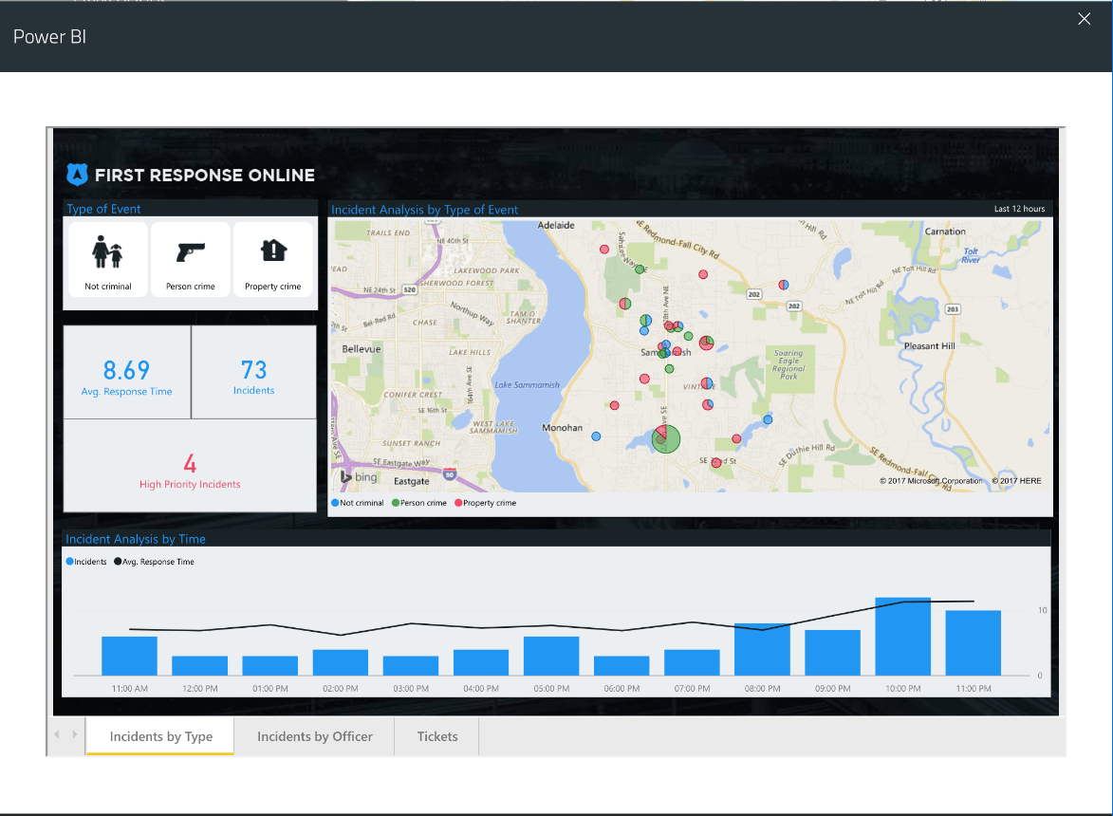
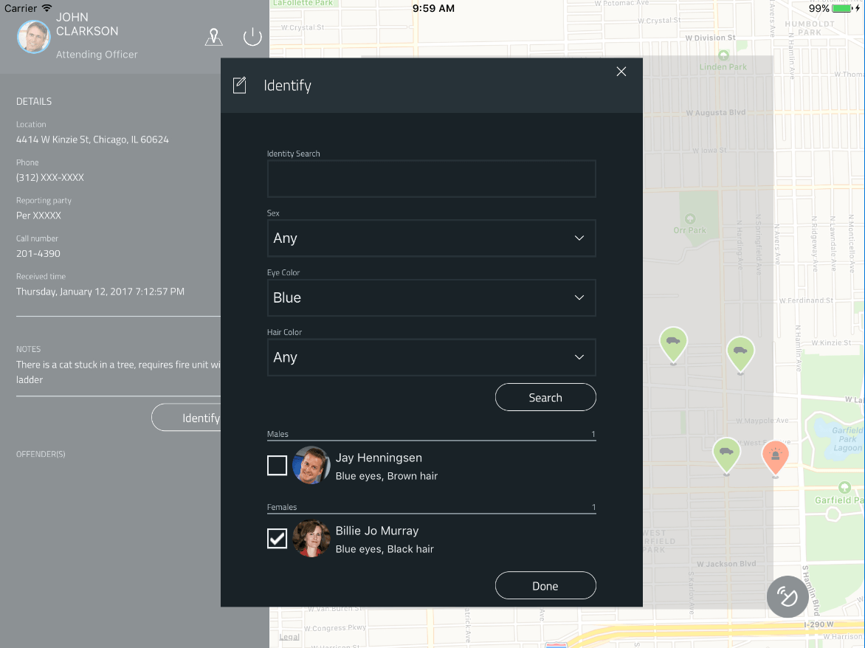
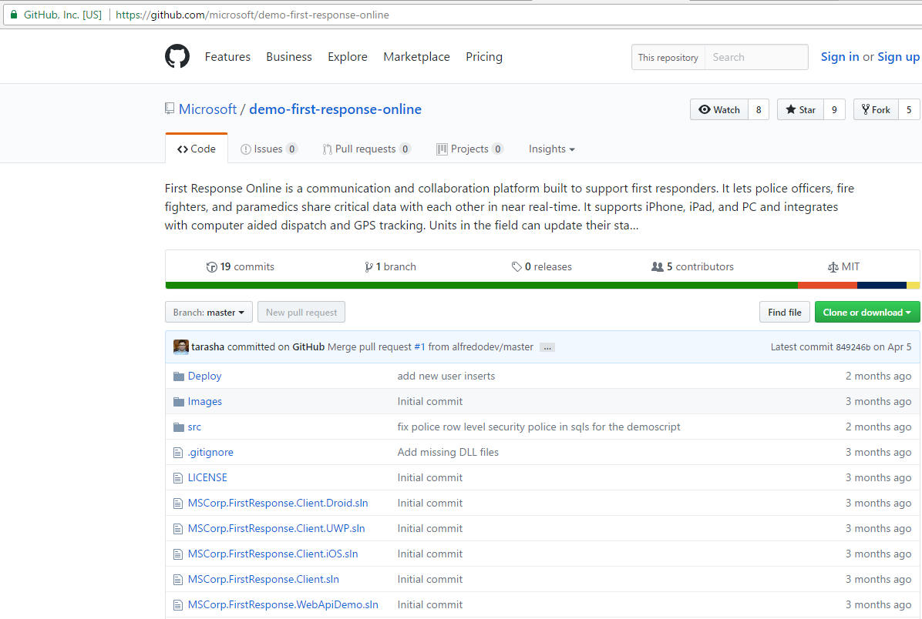
First Response Online
App Description:
First Response Online is a communication and collaboration platform built to support first responders. It lets police officers, fire fighters, and paramedics share critical data with each other in near real-time. It supports all devices, and PC and integrates with computer aided dispatch and GPS tracking. Units in the field can update their status, complete traffic stops, and even query state & federal databases all without using the radio.
Technology Used:
Front End: ASP.NET MVC API (C# backend, WebAPI, Entity Framework, Power BI Embedded), Xamarin.Forms
Database: Azure SQL
Azure Cloud Features: App Service, Azure SQL, DocumentDB & Azure Search
https://github.com/microsoft/demo-first-response-online
Red Hat ISV
and Advanced Partner
Click2Cloud Inc.
© 2017 – For Internal Use Only

Slide 38
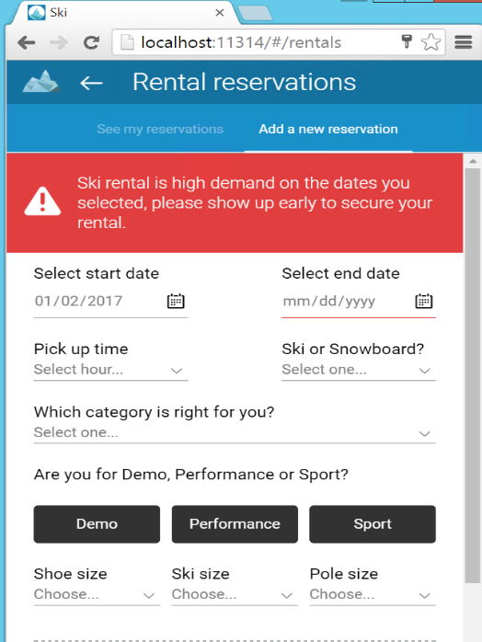
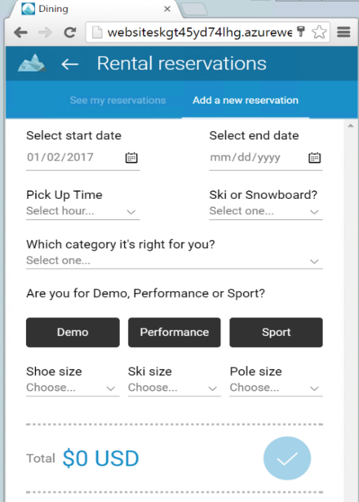
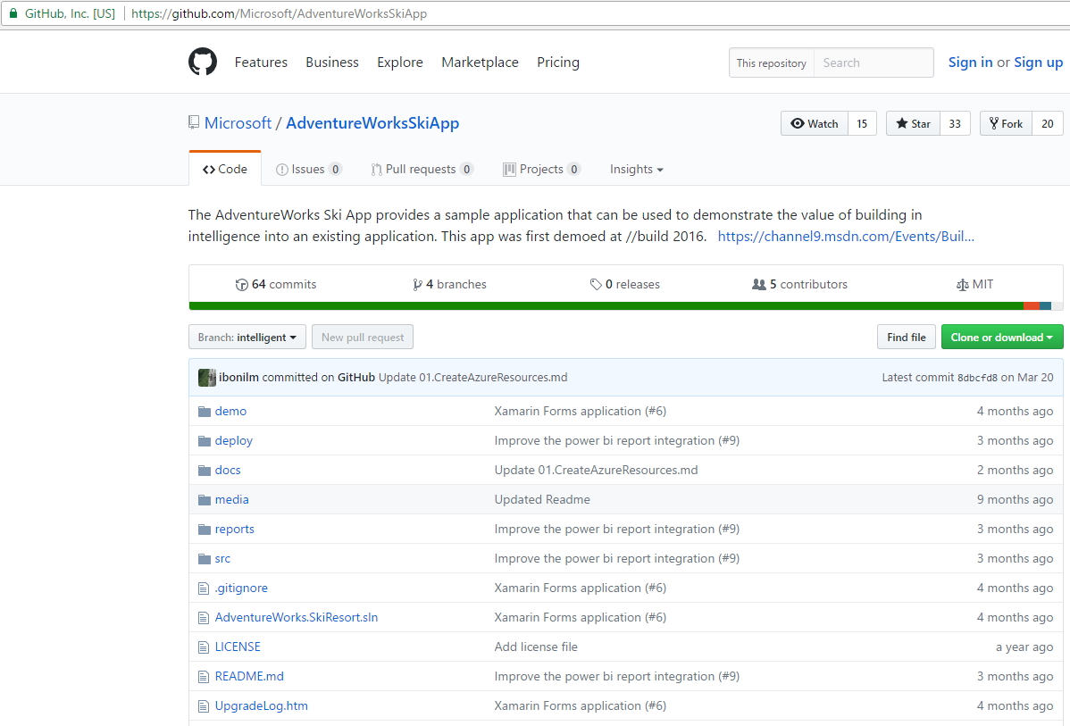
Demo SkiApp
App Description:
AdventureWorks Ski App provides a sample application that can be used to demonstrate the value of building in intelligence into an existing application. Applications show intelligence when they can spot trends, react to unusual events, predict outcomes or recommend choices.
Technology Used:
Front End: ASP.NET Core 1.0, SQL Server 2016 Developer Edition, Microsoft Azure SDK, (C# backend, WebAPI, Entity Framework), Xamarin.Forms
Azure Cloud Features: SQL Server 2016 Virtual Machine, Virtual Network, App Service, SQL Database, Stream Analytics, Event Hub, DocumentDB, Azure Storage, Search Service, Cognitive Services, and Application Insights
https://github.com/Microsoft/AdventureWorksSkiApp
Red Hat ISV
and Advanced Partner
Click2Cloud Inc.
© 2017 – For Internal Use Only

Slide 39
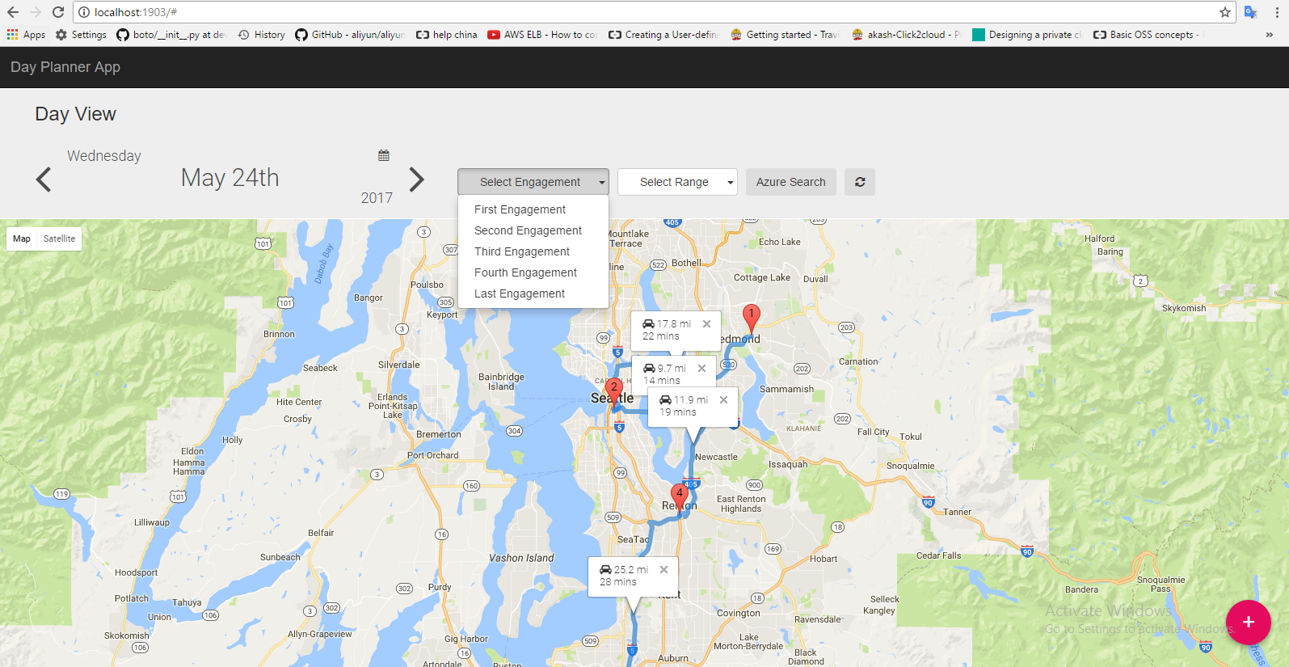
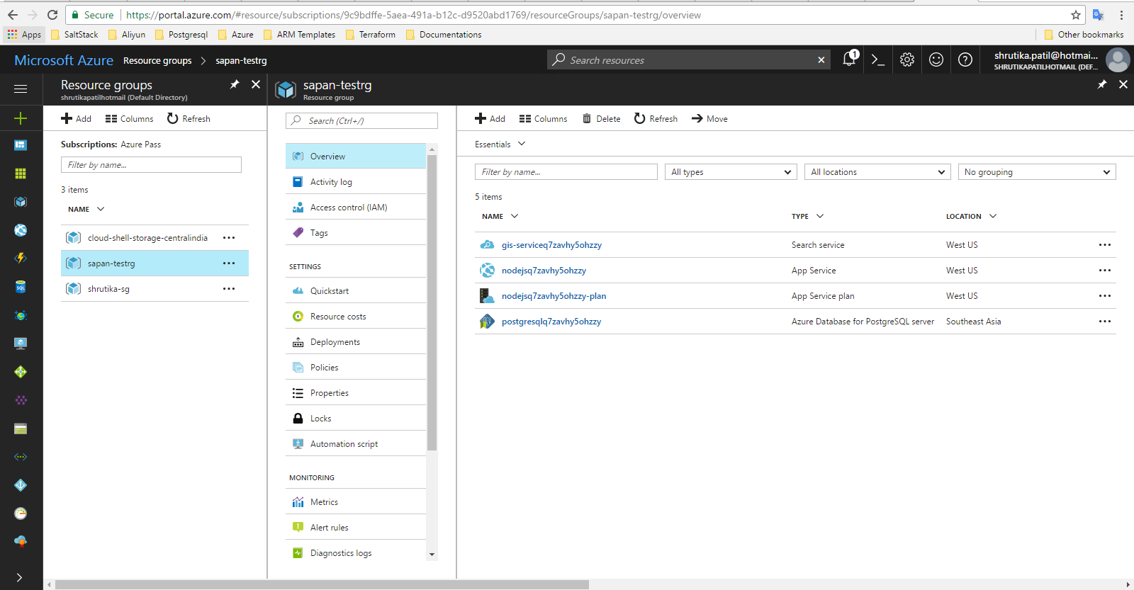
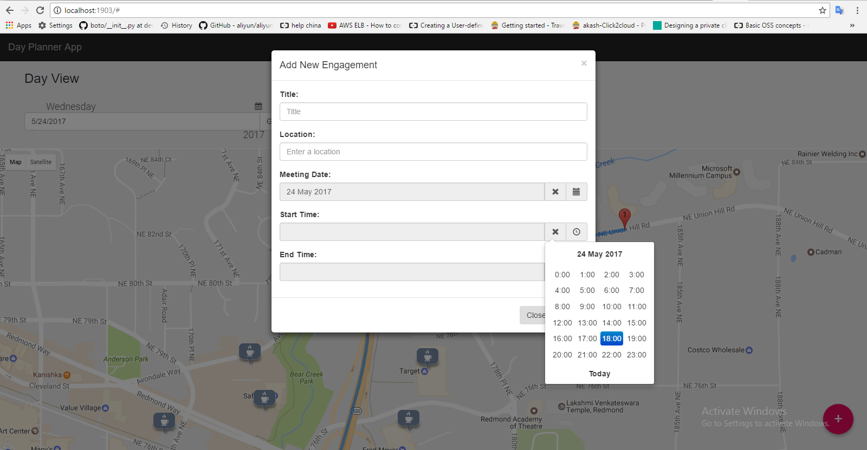
Day Planner App
App Description:
This application is developed to showcase the NodeJS and PostgreSQL (open source) integration capabilities with Microsoft Azure. The app manages the day-to-day schedule for a user and provides details of engagements on Google map. This app allows to save engagement details along with title, location, meeting date, start and end time of engagements. Once user selects date it search and displays all the engagements with the help of map of the date selected.
.
Technology Used:
Front End: NodeJS (MVC Framework for NodeJS apps, database, webpages) Google APIs, JQuery, Bootstrap, CSS
Database: PostgreSQL
Azure Cloud Features: App Service, Azure Database for PostgreSQL server, PostGIS, Azure Search Service, Azure Monitoring Service
Deployment Strategy – Azure Resource Manager (ARM)
Red Hat ISV
and Advanced Partner
Click2Cloud Inc.
© 2017 – For Internal Use Only

Slide 40
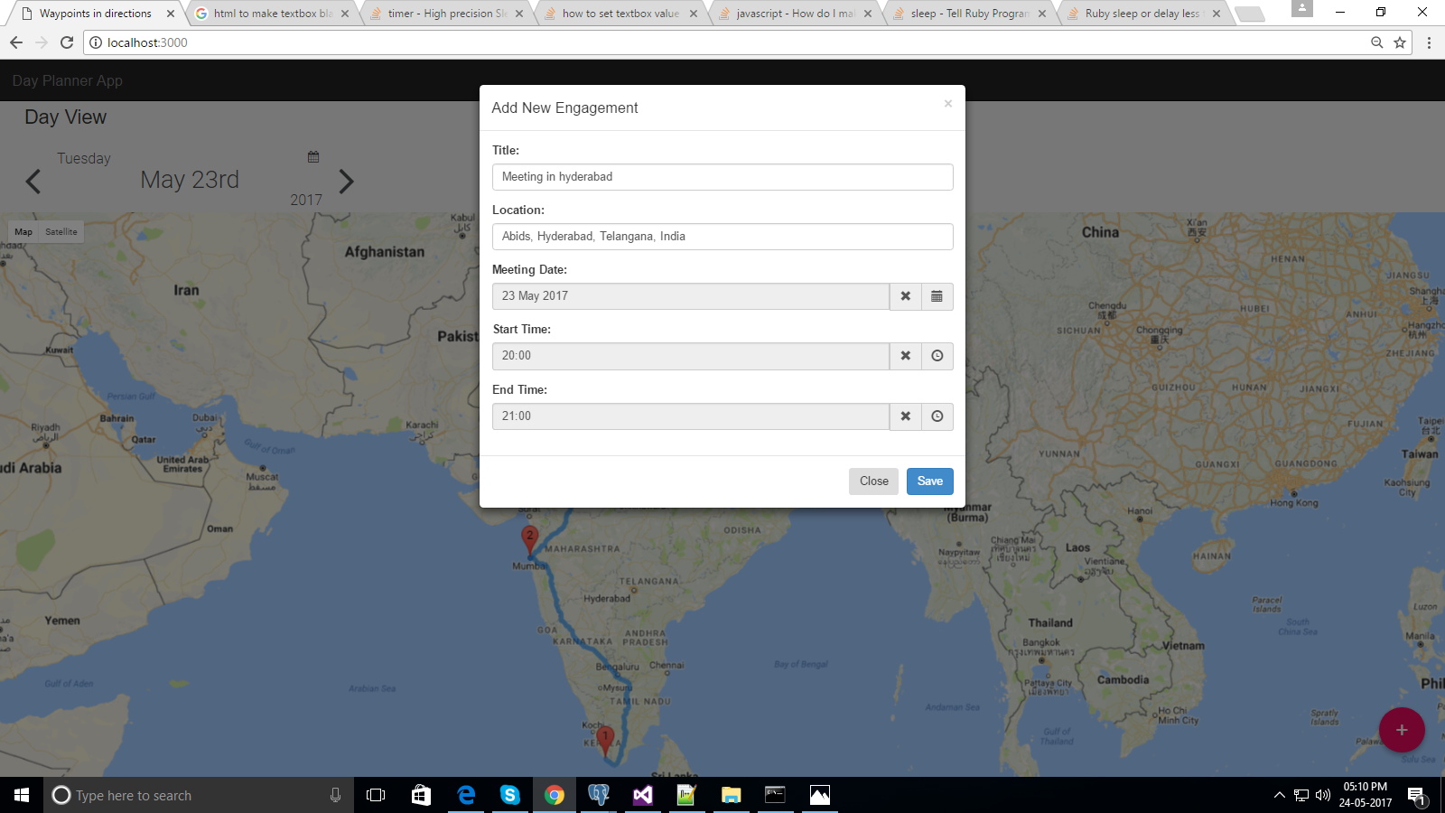
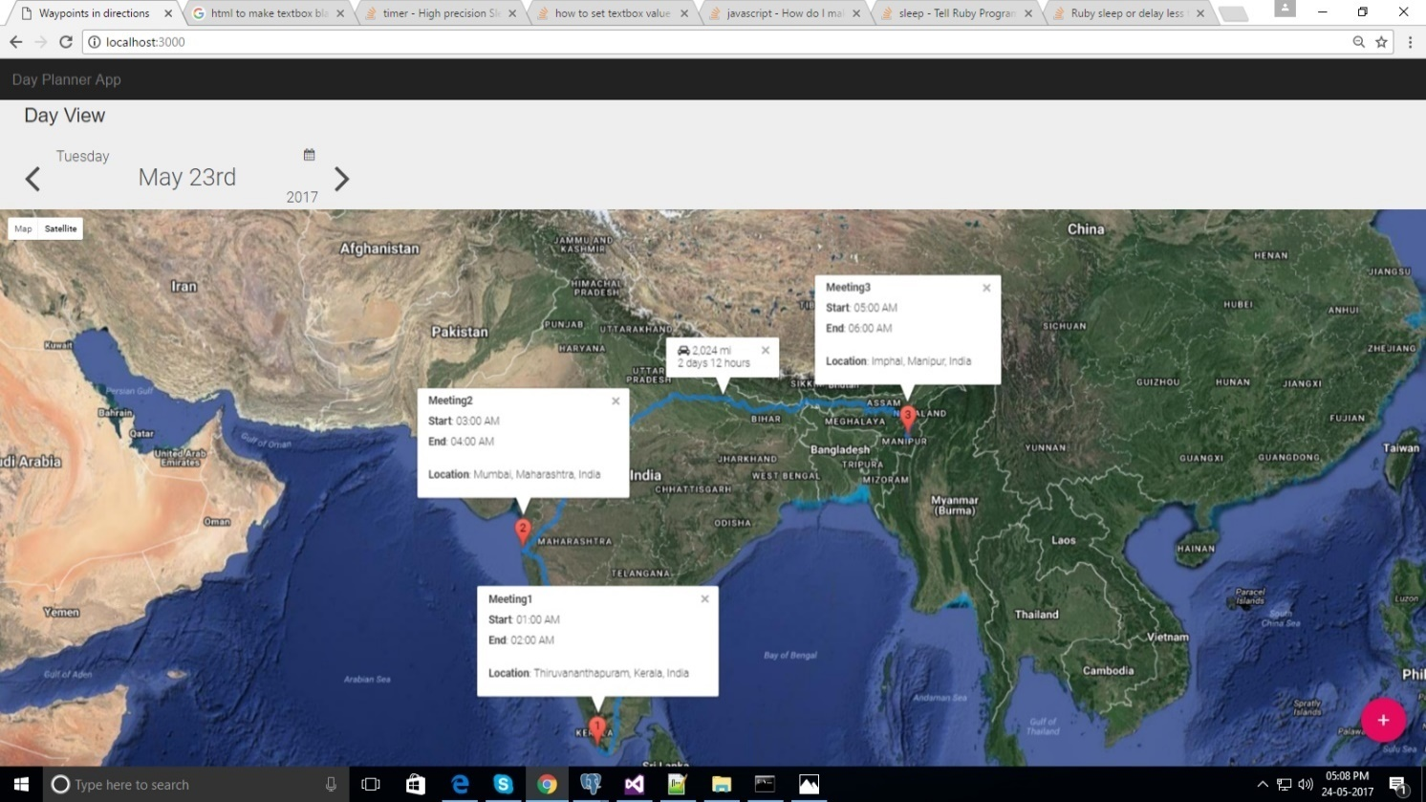
Meeting Directory
App Description:
This application is developed to showcase the Microsoft Azure capabilities to flawlessly work with Ruby-on-Rails as front end and database as PostgreSQL. The application helps users to record the meetings and view on the map in single view. It also provides the intelligence on the time duration for users to reach to each meetings. The phase II has been in progress to add various business feature from azure to make it as enterprise level application.
Technology Used:
Front End: Ruby on Rails (MVC Framework for Ruby apps, database, webpages) Google APIs, JQuery, Bootstrap, CSS
Database: PostgreSQL,
Azure Cloud Features: App Service, Azure Database for PostgreSQL server, PostGIS, Azure Search Service, Azure Monitoring Service.
Deployment Strategy – Azure Resource Manager (ARM)
Red Hat ISV
and Advanced Partner
Click2Cloud Inc.
© 2017 – For Internal Use Only

Slide 41







Case Study – Savers Migration (On-premise to Azure Cloud)
Technologies Used
PROPOSED SOLUTION:
Centralization, Standardization, Eliminate Waste, Lift and Shift
Moved their legacy SharePoint 2010 environment to SharePoint Online
Use Sharegate to migrate their 3.6TB of data and implement a new taxonomy set
Use PowerShell for various clean-up efforts (remove orphaned users, run updates)
Re-architect their environment in O365 so it’s more centralized, automated and ‘cleaner’
.
THE CLIENT: Savers is a family of stores is a global thrift retailer offering great quality, gently used clothing, accessories and household goods for sale across their nearly 400 stores in the U.S., Canada and Australia. They help to remove over 700 million pounds of used goods out of landfills each year through their reduce, reuse and recycle community business model.
PROBLEM SUMMARY: for their internal CMS platform, the client was facing performance, access, data redundancy and content sharing issues. Along with that, they had a poor deployment and content management strategy, causing them huge inefficiencies and overlap: 180 team sites (many unused), 800+ orphaned users, 177 custom features, 150 workflows, etc.
END RESULT: We eliminated much waste, created more efficiencies and thus brought value to the company and its customers:
Built & deployed a new central site with an improved site deployment process, taxonomy structure, and security model
All data successfully migrated to SharePoint Online; with improved performance, access, security and overall user efficiency
Replaced InfoPath forms with customized SharePoint forms (using JS and CSS); creating greater efficiencies to core processes
Other value-add services like proper indexing for Federated Search, Power BI report creation and removal of redundant sites
Additionally: we also deployed a UAT Application onto their Azure Services Portal for use in their deployment of Dynamics AX

Slide 42
List of Projects migrated to Microsoft Azure
Migration Projects
MCS Sites
Consolidated Business Intelligence
Enterprise Library Network
OEM and Product Marketing
Merrill Gardens
Legal Clinic Migration
UAG H-Cloud Migration
UAT Tool Migration
Island County
Savers Migration
10
Enterprise Projects Migrated to Azure
Red Hat ISV
and Advanced Partner
Click2Cloud Inc.
© 2017 – For Internal Use Only

Slide 43





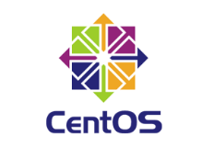



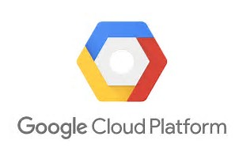
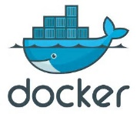
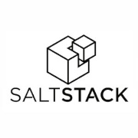









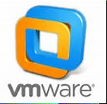
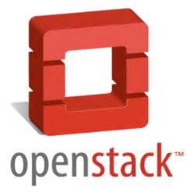

Click2Cloud in the Cloud Ecosphere
Where does C2C sit in the world of cloud services, and what are the value-adds? See below:
Workflow and IT Automation
Format / Platform
Environment
VALUE-ADD:
APPLICATION CONTAINERIZATION
VALUE-ADD:
CIA* SERVICES
VALUE-ADD:
MIGRATION SERVICES
Company
Performing feature analysis for various cloud service providers and automating some services, or creating plug-ins for their products to work on across multiple environments.
Providing both custom and ready-made container services for dBs (SQL, NoSQL) apps, as well as IDE plugins (Visual Studio, Eclipse) that can be push apps to any platform.
On-Prem to cloud migration services for various clients.
Getting to the cloud can be a complex process for the average customer; our goal is to provide key value-add services at key points in the cloud deployment process, adding more flexibility to what they deploy.
In the end, users will have a better overall user experience.
End User
Red Hat ISV
and Advanced Partner
Click2Cloud Inc.
© 2017 – For Internal Use Only

Slide 44
Typical use cases for Huawei Automation
Provisioning - To deploy OS on bare-metal, configure servers, networks, firewalls etc., deploy and manage frameworks such as VMWare, OpenStack on both on-premise and Cloud (Private, Public, Hybrid)
Configuration Management - To manage software configurations, patches on single or multiple nodes
App Deployment - To deploy multi-tier applications reliably and consistently, all from one common framework.
Continuous Delivery - To roll out new updates with Zero downtime
Security & Compliance – To define security for systems like; setting firewall rules, locking down users and groups, or applying custom security policies
Orchestration – To bring proper order for deployment of; frontend and backend services, databases, monitoring, networks and storage
DevOps Users Use Multiple Tools
Less than half (43 percent) of companies are using a configuration tool such as Chef, Puppet, Ansible, or Salt.
Use of multiple configuration tools is more common (25 percent) than a single configuration tool (18 percent).
67 percent of companies using Chef or Puppet also use the other tool.
Red Hat ISV
and Advanced Partner
Click2Cloud Inc.
© 2017 – For Internal Use Only

Slide 45
Cloud Automation Service – Lift and shift
Business Cases to be covered:
Provisioning
Configuration management
App deployment
Technology Used – Chef Solution having;
Knife ECS Plugin
Kitchen ECS Plugin
Ohai ECS Plugin (Integrated with Knife ECS bootstrap template)
@ Scenario 1 – Lift and Shift On-Premise App To Alibaba
ECS – 15 Times faster setup
Configuring 50 ECS Instance
Automation – 100 Mins
Manual - 1500 Mins
Ex User: A IT Company
Objective: To Migrate 50 on premise server/application to Cloud.
Tasks:
Choose the Cloud Service Provider & Planning
Execute Automation;
Create ECS Instance (50 Instances), install and configure dependencies
Migrate 50 websites to various instances and launch applications
Configuration Time Saving With Chef Automation
Migration – 10 Timer faster
Migrate 50 websites
Automation – 100 Mins
Manual – 1000 Mins
Conclusion:
30-40% - Reduction in time-to-market by improved provisioning cycle time
~ 50% Reduction in manual health check effort
30-40% Reduced cost of operations
20-30% Enhanced Environment Efficiency through 30% reduction in IT Service Request Fulfilment

Slide 46
Stats for Common Use Cases
Use Case
1. Provisioning - Provision an instance creation
2. Configuration Management - apache package and service configuration.
3. App Deployment - App deployment for simple standalone application.
4. Security & Compliance -
5. Cloud Management – managing the instances and update instances.
Stats for: Creating 50 Instances
Vs
Creating 500 Instances
Minutes
Minutes
Tools used:
Key Features; for instance provisioning, comparing to Aliyun Tools
Click2Cloud Chef Recipes – improved instance provisioning by 100%
Click2Cloud Ansible Modules – improved instance provisioning by 200%

Slide 47
Cloud Automation Service - Demo
@ Scenario 2 – Deploy tiered applications
User: A IT Company
Tasks:
Choose the Cloud Service Provider & Planning
Execute Automation;
Create ECS Instance (4 Instance - 2 frontend, 1 backend, 1 LB)
Configure frontend, backend and LB instance
Deploy and Launch Application
Objective: To Setup Cloud Infrastructure and deploy tiered applications with frontend, backend and LB support
Technology: Aliyun Cloud Services & Chef
Configuration Time Saving With Chef Automation
ECS
1500%
Configuring 4 ECS Instance
Automation – 8 Mins
Manual – 120 Mins
Deployment
1500%
Configure Frontend, Backend and LB
Automation – 8 Mins
Manual – 120 Mins
Conclusion:
30-40% - Reduction in time-to-market by improved provisioning cycle time
~ 50% Reduction in manual health check effort
30-40% Reduced cost of operations
20-30% Enhanced Environment Efficiency through 30% reduction in IT Service Request Fulfilment
Red Hat ISV
and Advanced Partner
Click2Cloud Inc.
© 2017 – For Internal Use Only

Slide 48



Business Cases & Success Stories
NASA: INCREASING CLOUD EFFICIENCY
WITH ANSIBLE
“Ansible has allowed us to provide better operations and security to our clients. It has also increased our efficiency as a team.” View Case Study
SPLUNK: AUTOMATING CLOUD INFRASTRUCTURE WITH ANSIBLE
“ Every change we do in cloud gets deployed through Ansible now...except for the first time. The first time we have to figure out how to do it manually, and then we’ll make the playbook to do it.” View Case Study
IBM: AUTOMATING CLOUD INFRASTRUCTURE WITH CHEF
“Part of our infrastructure hasn’t been ported to Linux and Chef, yet. I keep seeing people re-doing things because they’re doing it manually. I keep saying, I can’t wait until that’s on Chef so we’re not doing that.” View Success Story
Red Hat ISV
and Advanced Partner
Click2Cloud Inc.
© 2017 – For Internal Use Only

Slide 49
Benefits with Click2Cloud Services
Click2Cloud Services brought to Huawei Cloud Platform:
Click2Cloud Infrastructure Automation: for various configuration management tools (Ansible, Chef, Puppet, Salt-Stack)
App Containerization Service: Docker container app development & deployment for customers on Huawei Cloud
Cloud Migration Services: from any private or public cloud over to Huawei Cloud (i.e. .Net Apps)
Container Extension for Visual Studio and Eclipse IDE
Resulting Benefits Brought to Huawei Cloud and their Customer Base:
App Containerization Benefits (Faster to market, simplified and faster configurations, rapid deployment, increased productivity)
More diverse offerings; satisfies more customer segments overall
Faster to market for certain services (i.e. SQL on Linux running in Private or Public Cloud)
Market penetration into AWS: client can maintain their IDE focus, not have to switch
Can speak to more services in the DevOps space for Huawei Cloud
Red Hat ISV
and Advanced Partner
Click2Cloud Inc.
© 2017 – For Internal Use Only

Slide 50
Why Click2Cloud?
We understand you competitor better, and we know
我们了解您的竞争对手更好，我们知道
What your competitor are doing
你的竞争对手在做什么
How your competitors are doing it
你的竞争对手如何做
Why your competitors are doing it
为什么你的竞争对手正在做这件事
How your competitors will deliver it
您的竞争对手将如何交付它
When your competitor will deliver it
当您的竞争对手将交付它
Red Hat ISV
and Advanced Partner
Click2Cloud Inc.
© 2017 – For Internal Use Only

Slide 51
Why Click2Cloud?
We can easily adopt Huawei’s work culture and deliver your expectations
We’ve surpassed the “language barrier” and brought the comfort in communication
W
H
Y
U
S
?
Culture
We provide on-time delivery with high quality, and
we respect Huawei as our partner, and committed to offer excellent & world class services
Commitment
Innovation
We offer a blend of creative and technically expert team
We’re agile, ethical, & can change the plan as per Huawei’s business need
Transparency
We bring in the transparency of budget and bills
We bring in the transparency in execution process and status reporting
Cost Effective
We offer free POC (cost on us) & pass-on technical expertise to our clients
We offer best rates, legitimate discounts, and manages minor CRs
Red Hat ISV
and Advanced Partner
Click2Cloud Inc.
© 2017 – For Internal Use Only

Slide 52
Contact US
At Click2Cloud Inc., we care about your growth. We combine the most suitable technologies with intellect and expertise to help customers meet their swiftly changing needs of global business models and dynamic requirements for sophisticated technology solutions to meet their business requirements.
Contact Prashant Mishra
Click2Cloud Headquarters
Click2Cloud India Headquarters
1000 124th Ave NE
Bellevue, WA 98005, USA.
Phone: +1-425-748-9666
Email: contact@click2cloud.net
Website: www.click2cloud.net
V-8, Laxmi Nagar,
Nagpur – 440022
Phone: +91-712-3207999
Email: contact@click2cloud.net
Website: www.click2cloud.net
Prashant Mishra
Principal
Mobile:
Phone:
Email:
425 260 8052
425 748 9666
pm@click2cloud.net
Red Hat ISV
and Advanced Partner
Click2Cloud Inc.
© 2017 – For Internal Use Only

